Slide 1

Tokenization and Weighting
Klara Venglarova

Slide 2
Outline
Big Picture: Where are we and why?
Text Pre-Processing
Tokens and Tokenization
Frequencies
Bag-of-Words Representation and CountVectorizer
TF-IDF and c-TF-IDF

Slide 3
Where are we and Why?
Texts
Model
BUT: Machine-learning models perform mathematical operations on numerical representations, so we need to transform our text into numbers
This involves several steps: (next slide)

Slide 4
Texts
Model
Pre-processing and tokenization (tokenize = turn the continuous text into smaller units such as words or subwords)
Vectorization = turning these units into numbers
(vector = „list of numbers“)
Vectors as inputs into the model

Slide 5
Text Pre-Processing in NLP
Pre-processing is the set of steps applied to raw text to
  clean,
  normalize, and
  standardize
it so that it can be effectively processed by NLP models.

Slide 6
Text Pre-Processing in NLP: Why?
Raw text is messy: punctuation, capitalization, typos, numbers, stopwords, emojis.
Pre-processing helps:
  Reduce noise → fewer meaningless tokens
  Normalize text → make similar words consistent (run vs. running)
  Reduce dimensionality → smaller, cleaner vocabulary
I am running to a school.

Slide 7
Common Pre-Processing Steps
Lowercasing: Convert all text to lowercase
  e.g.: “Galaxy” → “galaxy”
Punctuation removal: Remove symbols, commas,...
  e.g.: “far, far away...” → “far far away”
Stopwords removal: Remove common words that add little meaning
  e.g.: “in a galaxy” → “galaxy”
  A long time ago in a Galaxy far, far away...

Slide 8
Common Pre-processing Steps II.
Tokenization: Split text into small units (e.g. words/subwords)
  e.g.: “long time ago” → [“long”, “time”, “ago”]
Lemmatization: Reduce words to their base form
  e.g.: “running” → “run”
Stemming: Reduce words to their root form
  “better“→ “bet“
POS tagging: Adding information about Part-of-the-speech
  e.g.: [“long”, “time”] → [“long_ADJ”, “time_NOUN”]

Slide 9
Tokenization
Token = the smallest unit of text, such as a word, subword or punctuation mark
Tokenization = the process of breaking text into these units
„a smart dog“ >> „a“, „smart“, „dog“
Token =? Word
Matter of definition: Henry V. = one word or two?
  U.S.A.
  E-Mail
  Rock ‘n‘ roll
  New York

Slide 10
Types and Tokens
Token = every single unit in a text, individual instances
Type = a dictionary of all words used in a text (all unique words in a text)
Example (if token = words):
„a smart dog is using a smart phone“
Tokens: a, smart, dog, is, using, a, smart, phone
Types: a, smart, dog, is, using, phone

Slide 11
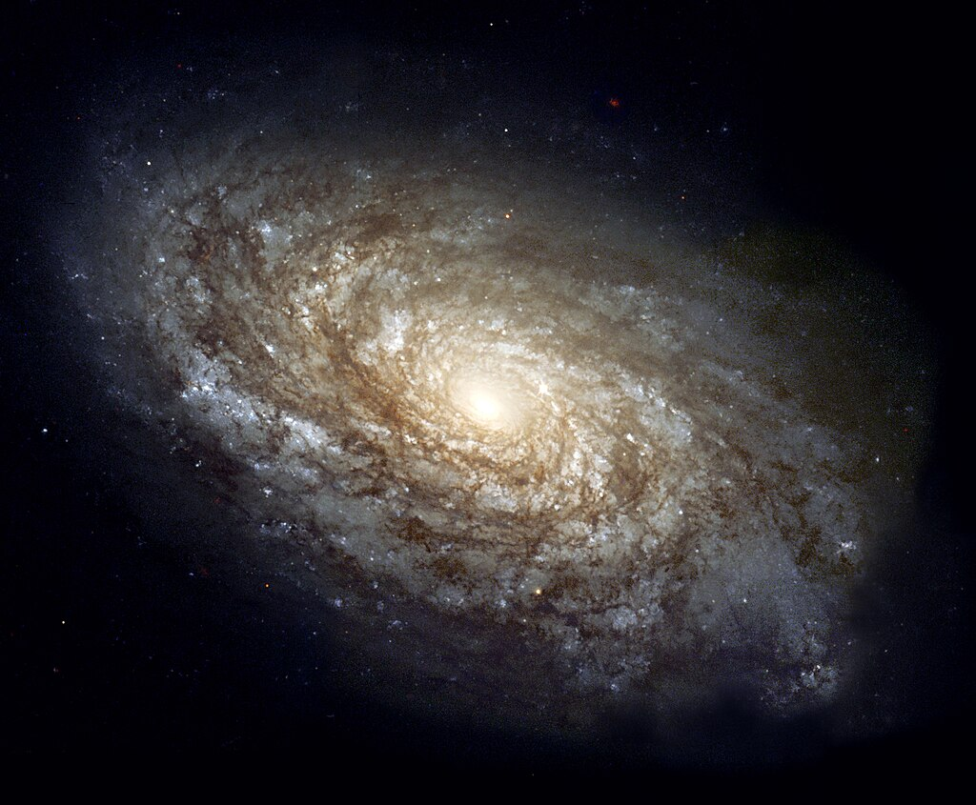
Exercise
„a long time ago in a galaxy far, far away“
if token == word and we ignore interpunction:
How many tokens?
How many types?
Tokens: a, long, time, ago, in, a, galaxy, far, far, away {10}
Types: a, long, time, ago, in, galaxy, far, away {8}
Source: https://en.wikipedia.org/wiki/Galaxy#/media/File:NGC_4414_(NASA-med).jpg

Slide 12
Tokenization
other units than words
In BERT – subword tokenization using WordPiece
Example of the principle: “unhappiness” → [“un”, “##happy”, “##ness”]
“translatability” → [“translate”, “##ability”]
Out-of-vocabulary words („unforgetability“)
more information here: https://huggingface.co/learn/llm-course/chapter6/6

Slide 13
Frequencies
frequency of a type = how many times it appears in the document
„a long time ago in a galaxy far, far away“
frequency of far = 2
frequency of galaxy = 1

Slide 14
Bag-of-Words Representation (BoW)
Bag-of-Words (BoW) is a text representation method that converts a document into a vector based on the frequency (or presence) of words, ignoring grammar and word order.
Turns the document into a matrix of types and their frequencies.
Turning text into a BoW vector = feature extraction or vectorization.

Slide 15
Bag-of-Words
Corpus = ["dog cat dog",
"cat bird"]
features
Document bird cat dog
1 0 1 2
2 1 1 0

Slide 16
BoW Creation Steps I.
A long time ago in a galaxy far, far away…
Tokenization (+ lowercase)
[a, long, time, ago, in, a, galaxy, far, far, away]
2. Build Vocabulary (from types = unique words)
{a, long, time, ago, in, galaxy, far, away}

Slide 17
BoW Creation Steps II.
3. Count Word Frequencies [a, long, time, ago, in, a, galaxy, far, far, away]
Word Count
a 2
long 1
time 1
ago 1
in 1
galaxy 1
far 2
away 1

Slide 18
BoW Creation Steps III.
4. BoW Vector
If we order the vocabulary as:
[a, long, time, ago, in, galaxy, far, away]
Then the BoW vector is:
[2, 1, 1, 1, 1, 1, 2, 1]

Slide 19
BoW Creation Steps IV.
differently written as:
a long time ago in galaxy far away
2 1 1 1 1 1 2 1

Slide 20
BoW Creation
We want to add a second sentence: A galaxy is far away.
a long time ago in galaxy far away is
sentence 1 2 1 1 1 1 1 2 1 0
sentence 2 1 0 0 0 0 1 1 1 1

Slide 21
CountVectorizer
In Python, CountVectorizer is a tool that turns a collection of text documents into a Bag-of-Words representation, i.e. matrix of token counts, showing how many times each word appears in each document.

Slide 22
CountVectorizer and its Parameters
1. binary → Frequency vs. Binary BoW
Default (binary=False) → Counts word frequencies.
  "far" appears twice → value = 2.
Binary (binary=True) → Marks only presence (1) or absence (0).
  "far" appears twice = is present → value = 1.
👉 Use case: when repetition doesn’t matter (e.g., spam detection — presence of “buy”, “free”, “offer” is enough).

Slide 23
N-grams
Unigrams: [a, long, time, ago, in, a, galaxy, far, far, away]
Bigrams:
a long, long time, time ago, ago in, in a, a galaxy, galaxy far, far far, far away
Trigrams:
a long time, long time ago, time ago in, ago in a, in a galaxy, a galaxy far, galaxy far far, far far away
4-grams:
a long time ago, long time ago in, time ago in a, ago in a galaxy, in a galaxy far, a galaxy far far, galaxy far far away

Slide 24
N-grams: Exercise
The solar system has eight planets.
Bi-grams:
Tri-grams:
[„The solar“, „solar system“, „system has“, „has eight“, „eight planets“]
[„The solar system", „solar system has“, „system has eight“, „has eight planets“]

Slide 25
CountVectorizer: ngram_range
2. ngram_range
Default: (1,1) → unigrams only (single words).
(1,2) → unigrams and bigrams.
  Example: "far away" becomes its own token as well as “far” and “away”.
(2,2) → only bigrams.
👉 N-grams capture phrases and order — helps when word combinations carry meaning.

Slide 26
N-Grams
Why using n-grams?
Henry V.
New York
far away
not happy

Slide 27
CountVectorizer: max_features
3. max_features
Restricts vocabulary to the top k most frequent words.
Example: if max_features=5, only the 5 most common words across the corpus are kept.
👉 Useful for very large corpora where the full vocabulary would explode in size.

Slide 28
CountVectorizer: min_df and max_df
4. min_df and max_df
min_df = minimum number (or proportion) of documents a word must appear in to be included.
  Example: min_df=2 → ignore words that appear in only 1 document.
max_df = maximum number (or proportion) of documents a word can appear in.
  Example: max_df=0.9 → ignore words that appear in more than 90% of documents (often stopwords).
👉 These help clean the vocabulary:
Drop rare words (too specific, not generalizable).
Drop very common words (uninformative, e.g., “the”, “is”).

Slide 29
CountVectorizer: Stop Words
5. stop_words
Removes common words (like “the”, “in”, “a”).
Built-in: "english", or a custom list.
prepositions, articles, pronouns…
👉 Prevents filler words from dominating the BoW.

Slide 30

Stop Words: Exercise
Which words would you consider stop words?
Anyway, the weather will be nice.
Anyway, the weather will be nice.
Source: https://cdn-icons-png.flaticon.com/512/10127/10127236.png

Slide 31
CountVectorizer: lowercase
6. lowercase
Default = True.
Converts all text to lowercase → “Galaxy” = “galaxy”.
(opposite: UPPERCASE)

Slide 32
CountVectorizer: token_pattern
7. token_pattern
Regex that defines what counts as a “word.”
Default: tokens of 2 or more alphanumeric characters ('(?u)\\b\\w\\w+\\b').
Can be customized to include single letters (like “a” or “I”), or handle special symbols.

Slide 33
CountVectorizer in Python
from sklearn.feature_extraction.text import CountVectorizer
import pandas as pd
docs = [
"A long time ago in a galaxy far, far away.",
"The galaxy is far away."
]

Slide 34
CountVectorizer in Python
# Custom CountVectorizer
vectorizer = CountVectorizer(
lowercase=True, # convert all text to lowercase
stop_words='english', # remove English stopwords like "the", "in"
binary=True, # binary bag-of-words (presence/absence)
ngram_range=(2,2), # include only bigrams
min_df=1, # token must appear in at least 1 document
max_df=0.9 # ignore tokens appearing in >90% of docs
)
# Fit and transform - fit to train the features dictionary and then transform to transform text into a vector:
X = vectorizer.fit_transform(docs)

Slide 35

CountVectorizer in Python
df = pd.DataFrame(X.toarray(), columns=vectorizer.get_feature_names_out())
print(df)

Slide 36
BoW Advantages
an easy representation to start with
simplicity - to understand, explain, and implement
implementation in Python libraries
allows for certain flexibility (n-grams, lemmatization, stopwords...)
effective baseline - often performs surprisingly well for tasks like spam detection, sentiment analysis, or document classification
interpretability - features (words) are human-readable, so you can see which words drive predictions

Slide 37
Problems with BoW
BoW loses words order
BoW misses context
BoW treats all words equally
Common words might dominate just because they appear often, not because they’re informative.
Example: in a large corpus, words like “the” or “said” would drown out more meaningful words.
High dimensionality
Extreme matrix sparsity (most of the matrix are actually ‚0‘)
?Do all words carry the same importance?

Slide 38
TF-IDF
Term Frequency – Inverse Document Frequency
TF = how often a term appears in a document
  the more frequently a word appears in a single document, the more important that term is to the document
IDF = how unique a term is across documents
  words that appear more frequently in the corpus give less insight into the topic or meaning of an individual document

Slide 39
TF-IDF II.
Combined → weights words higher if they are frequent in one document but rare across others
indicate how important a word is to each document in a collection of documents, or a corpus
a higher TF-IDF score indicates a term is more important to the corresponding document

Slide 40
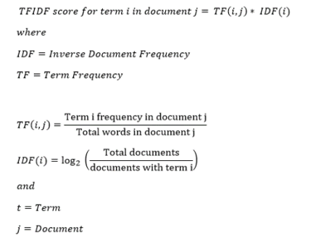
source: https://mungingdata.wordpress.com/2017/11/25/episode-1-using-tf-idf-to-identify-the-signal-from-the-noise/

Slide 41
TF-IDF
docs = ["A long time ago in a galaxy far, far away.",
"A planet in a different galaxy is far away."]
"galaxy" appears in both → IDF is low → less important.
"long" or “planet” appears only in one of the sentences → IDF is high → more important.

Slide 42
TF-IDF: Example
example taken from: https://www.geeksforgeeks.org/machine-learning/understanding-tf-idf-term-frequency-inverse-document-frequency/
let’s count TF-IDF for a term in 3 documents:
Document 1: "The cat sat on the mat."
Document 2: "The dog played in the park."
Document 3: "Cats and dogs are great pets."
Let’s focus on the word "cat"

Slide 43
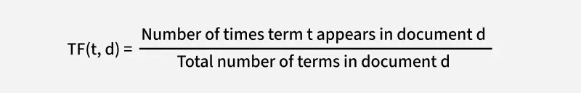
Step 1: Calculate Term Frequency (TF)
Document 1: "The cat sat on the mat."
For Document 1:
The word "cat" appears 1 time.
The total number of terms in Document 1 is 6 ("the", "cat", "sat", "on", "the", "mat").
So, TF(cat,Document 1) = 1/6

Slide 44
Document 2: "The dog played in the park."
For Document 2:
The word "cat" does not appear.
So, TF(cat,Document 2)=0.

Slide 45
Document 3: "Cats and dogs are great pets."
For Document 3:
The word "cat" appears 1 time.
The total number of terms in Document 3 is 6 ("cats", "and", "dogs", "are", "great", "pets").
So TF (cat,Document 3)=1/6

Slide 46
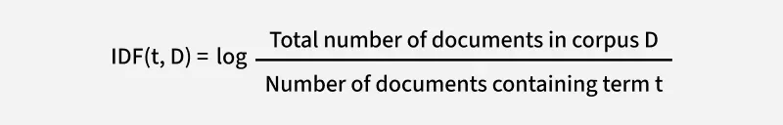
Step 2: Calculate Inverse Document Frequency (IDF)
Total number of documents in the corpus (D): 3
Number of documents containing the term "cat": 2 (Document 1 and Document 3).
IDF(cat,D)=log 3/2 ≈ 0.176

Slide 47
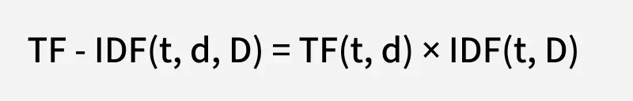
Step 3: Calculate TF-IDF
For Document 1: TF-IDF (cat, Document 1, D) = 0.167 * 0.176 = 0.029
For Document 2: TF-IDF(cat, Document 2, D) = 0 * 0.176 = 0
For Document 3: TF-IDF (cat, Document 3, D) = 0.167 * 0.176 = 0.029

Slide 48
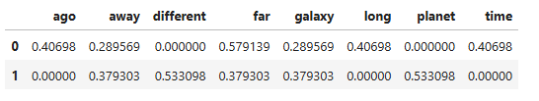
TF-IDF in Python
docs = ["A long time ago in a galaxy far, far away.",
"A planet in a different galaxy is far away."]
from sklearn.feature_extraction.text import TfidfVectorizer
tfidf = TfidfVectorizer(stop_words='english')
X_tfidf = tfidf.fit_transform(docs)
pd.DataFrame(X_tfidf.toarray(), columns=tfidf.get_feature_names_out())
term-document
matrix →

Slide 49
TF-IDF Review
Term frequency-inverse document frequency, known as TF-IDF, is a numerical statistic used to indicate how important a word is to each document in a collection of documents
TF-IDF consists of two components, term frequency and inverse document frequency
term frequency is how often a word appears in a document
inverse document frequency is a measure of how often a word appears across all documents of a corpus
TF-IDF is calculated as the term frequency multiplied by the inverse document frequency
Source: https://www.codecademy.com/courses/intro-to-language-models-in-python/lessons/language-model-tf-idf/exercises/review

Slide 50
BoW vs. TF-IDF
BoW → frequency only. Shared/common words can overshadow distinctive ones.
TF-IDF → adjusts weights so rare-but-informative words stand out.

Slide 51
TF-IDF in Applications
Ranking results in search engines
TF-IDF scores help decide which documents are most relevant to a user query.
Text summarization
Selects the most “important” sentences or keywords by weighting unique terms higher.
Spam filtering / document classification
Words like “free”, “offer”, “win” may get high TF-IDF scores in spam messages, helping classifiers.
Keyword extraction
Identify key terms that represent a document, useful for tagging or indexing.

Slide 52
c-TF-IDF
c-TF-IDF stands for class-based TF-IDF
It’s a variation of regular TF-IDF used in BERTopic to find topic-specific keywords.

Slide 53
c-TF-IDF
Standard TF-IDF computes word importance per document.
In topic modeling, we cluster multiple documents together into a topic.
We want words that distinguish one topic from others, not just frequent words in one single document.
💡 Example:
Topic 1: Star Wars sentences
Topic 2: Planetary science sentences
Words like „spaceship" should stand out in Topic 1; words like „supernova" in Topic 2.

Slide 54
c-TF-IDF: How it works (conceptually)
Merge all documents in a topic into a single “super-document”.
Compute TF-IDF for each term across topics instead of documents.
TF (Term Frequency): frequency of the term in the topic’s super-document.
IDF (Inverse Document Frequency): log of (number of topics ÷ number of topics containing the term).

Slide 55
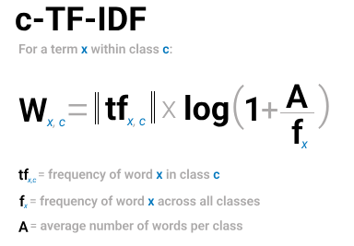
c-TF-IDF
Source: https://maartengr.github.io/BERTopic/getting_started/ctfidf/ctfidf.html

Slide 56
c-TF-IDF: Intuition
TF → how common the word is within the topic.
IDF → reduces weight for words that appear across many topics.
Outcome: words that are representative of a topic get high scores.
💡 Simple analogy:
Regular TF-IDF → “what words are important in this document?”
c-TF-IDF → “what words are important for this cluster of documents?”

Slide 57
c-TF-IDF: Example
Doc 1: "A long time ago in a galaxy far, far away."
Doc 2: "A planet in a different galaxy is far away."
Doc 3: “Pluto is not a planet anymore.”
Merged per topic:
Topic 1: "A long time ago in a galaxy far far away"
Topic 2: "A planet in a different galaxy is far away. Pluto is not a planet anymore.”
c-TF-IDF will highlight:
Topic 1 → "long", "time", "ago"
Topic 2 → "planet", "different", “Pluto”
Shared words like "galaxy", "far", "away" get lower scores

Slide 58
Problems with TF-IDF
it does not understand the semantics
similar words (‘cat’ and ‘kitty’) are treated as two separate units
homonyms (‘apple’ and ‘Apple’) are treated as identical (if lowercased)
Solution: Semantics is captured by another vector representation: semantic embeddings

Slide 59
Revision
c-TF-IDF
Bag-of-Words
CountVectorizer
TF-IDF
Tokenization
Pre-Processing
Frequencies
Clean and standardize raw text to make it suitable for analysis.
Split text into smaller units (tokens) such as words or subwords.
Count how often each token appears in a document or corpus.
Represent text as a vector of token counts, ignoring word order.
A Python implementation of BoW, with parameters for stopwords, n-grams, binary counts, and min/max document frequency.
Weight tokens by frequency in a document and rarity across documents to highlight important words.
Compute TF-IDF across topic clusters to identify words that distinguish one topic from others.

Slide 60
Revision
Preprocessing: Clean and standardize raw text to make it suitable for analysis.
Tokenization: Split text into smaller units (tokens) such as words or subwords.
Frequencies: Count how often each token appears in a document or corpus.
Bag-of-Words (BoW): Represent text as a vector of token counts, ignoring word order.
CountVectorizer: A Python implementation of BoW, with parameters for stopwords, n-grams, binary counts, and min/max document frequency.
TF-IDF: Weight tokens by frequency in a document and rarity across documents to highlight important words.
c-TF-IDF: Compute TF-IDF across topic clusters to identify words that distinguish one topic from others.

Slide 61
Take-Aways
What is pre-processing and why do we do it?
What are types and tokens?
What are n-grams?
What is Bag-of-Words? What is the difference between binary and frequency BoW?
What does TF-IDF do?

Slide 62
Want to learn more?
Vectorizers: https://maartengr.github.io/BERTopic/getting_started/vectorizers/vectorizers.html
c-TF-IDF: https://maartengr.github.io/BERTopic/getting_started/ctfidf/ctfidf.html
BERT Tokenization: https://huggingface.co/learn/llm-course/chapter6/6
interactive course aout BoW, TF-IDF and embeddings: https://www.codecademy.com/enrolled/courses/intro-to-language-models-in-python
TF-IDF: https://www.geeksforgeeks.org/machine-learning/understanding-tf-idf-term-frequency-inverse-document-frequency/

Slide 63


Thank you
klara.venglarova@uni-graz.at

